Slide 1


Business Problem 14 – Retail store in the USA

Slide 2

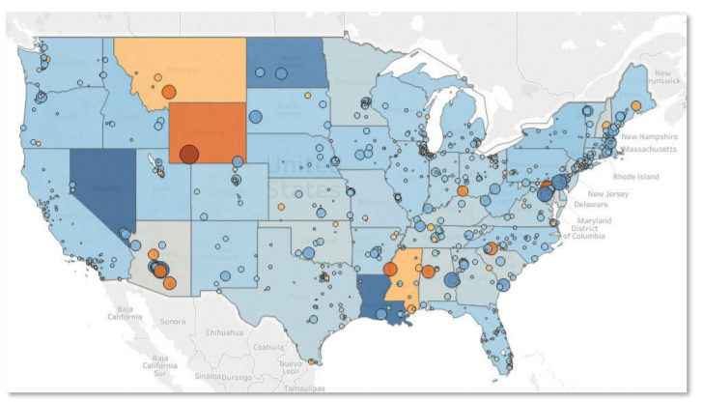
Use case:
You have been approached by a retail chain operating in the US.
They would like you to re-create the visualization, which is depicted as below
What we will learn today
What is LOD
Types of LOD
Include
Exclude
Fixed
State colours represent the average profit across the cities of that state
Circle colours and sizes show the percent contribution of the profit of the respective city towards the overall profit of the state

Slide 3
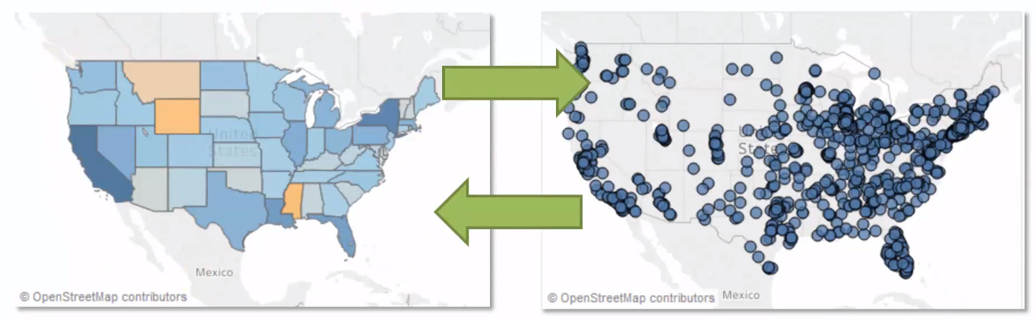
Three Types of LODs
Include

Slide 4
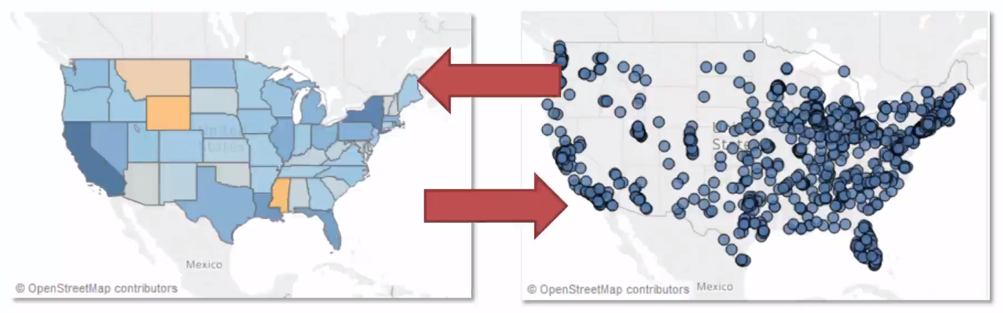
Three Types of LODs
Exclude

Slide 5
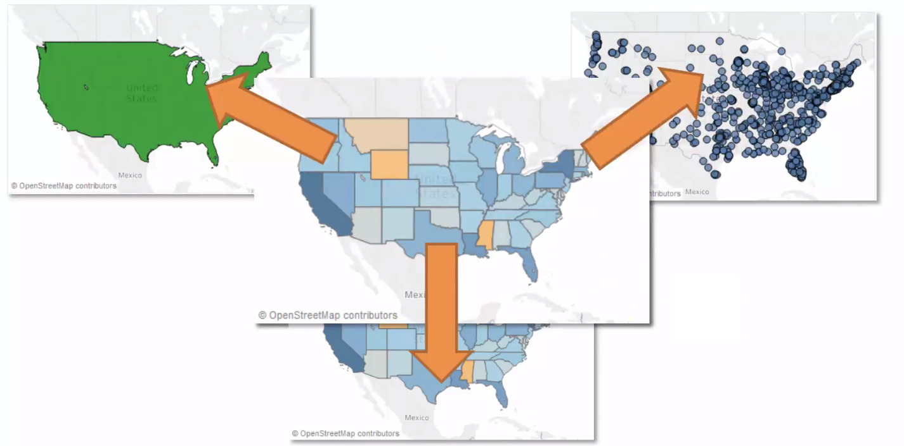
Three Types of LODs
Fixed

Slide 6
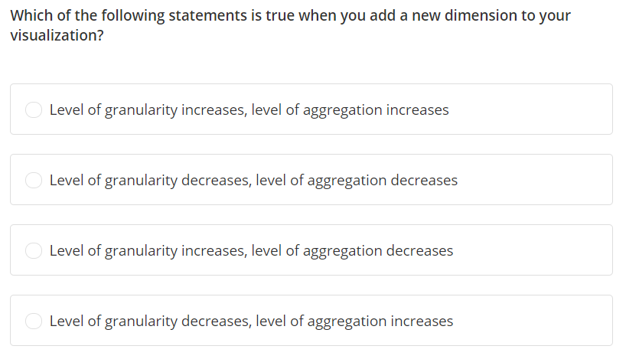

Slide 7
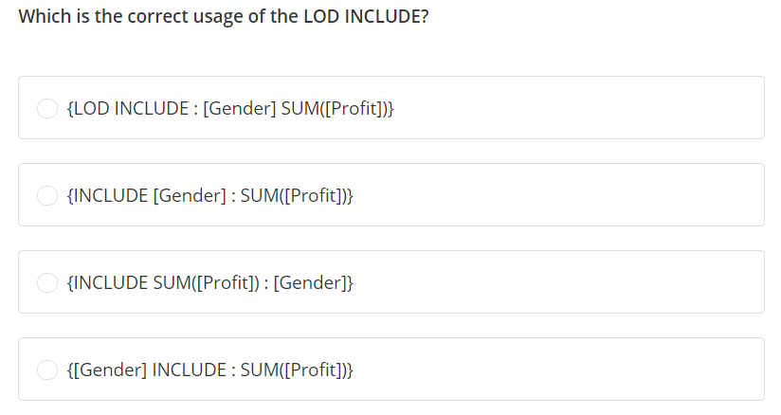

Slide 8
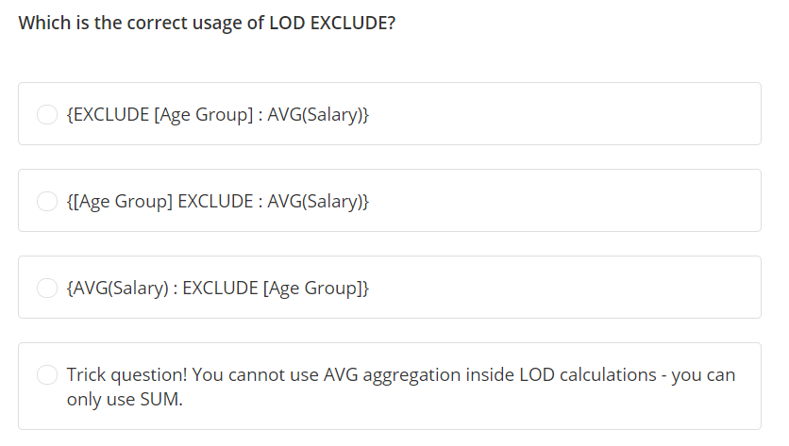

Slide 9
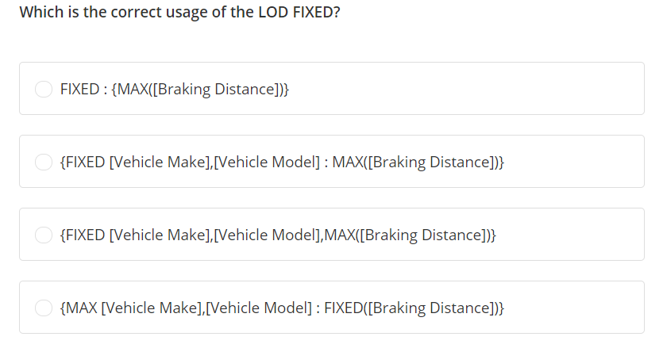

Slide 10
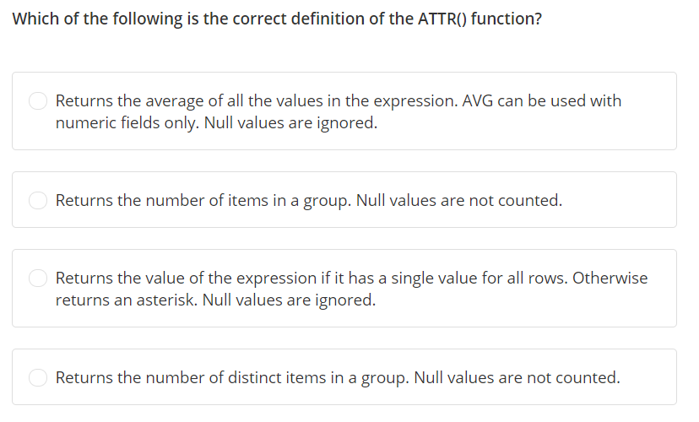

Slide 11
